Slide 1

Plenary Lecture
Fifty Years of Experimental Mechanics
-A personal Perspective
Fu-pen Chiang Ph.D.
F.ASME, F.SEM, F.OSA, F.SPIE
Presented at
ICEM 17, Rhodes, Greece, July 3-7, 2016

Slide 2
Chronology
Major Full Field Optical Techniques
Major Development Period
Birefringence Techniques:
  Photoelasticity
  Photoviscoelasticity
  Photoplasticity
  Before 1950’s
Moiré Methods:
  In-plane Moiré
  Shadow Moiré & Projection moiré
  Reflection Moiré
  Refraction Moiré & Moiré Deflectometry
  1960’s – 1970’s
Holographic Interferometry:
  1960’s – 1970’s
Moiré Interferometry & Two-Beam Interferometry:
  1980’s – 1990’s

Slide 3
Chronology
Major Full Field Optical Techniques
Major Development Period
Coherent Speckle Techniques:
  Two-Beam Laser Speckle Interferometry & ESPI (Electronic Speckle Pattern Interferometry)
  One Beam Speckle Interferometry (Speckle Photography)
  Shearography
  1970’s - 1980’s
Incoherent Speckle Techniques:
  White light Speckle Photography
  Image Correlation Technique
  1980’s
Digital Techniques:
  Digital Moiré
  Digital Projection Grating
  Digital Holography
  Digital Image Correlation (DIC)
  Digital Speckle Photography (DSP)
  1990’s
Micro/Nano Techniques:
  Electron Beam Moiré
  AFM Speckle Image Correlation Technique
  Electron Speckle Photography ( with SEM, TEM, etc. )
3D Digital Methods 2010’s
  Digital Volume Correlation (DVC)
  Digital Volumetric Speckle Photography( DVSP)
  2000’s

Slide 4
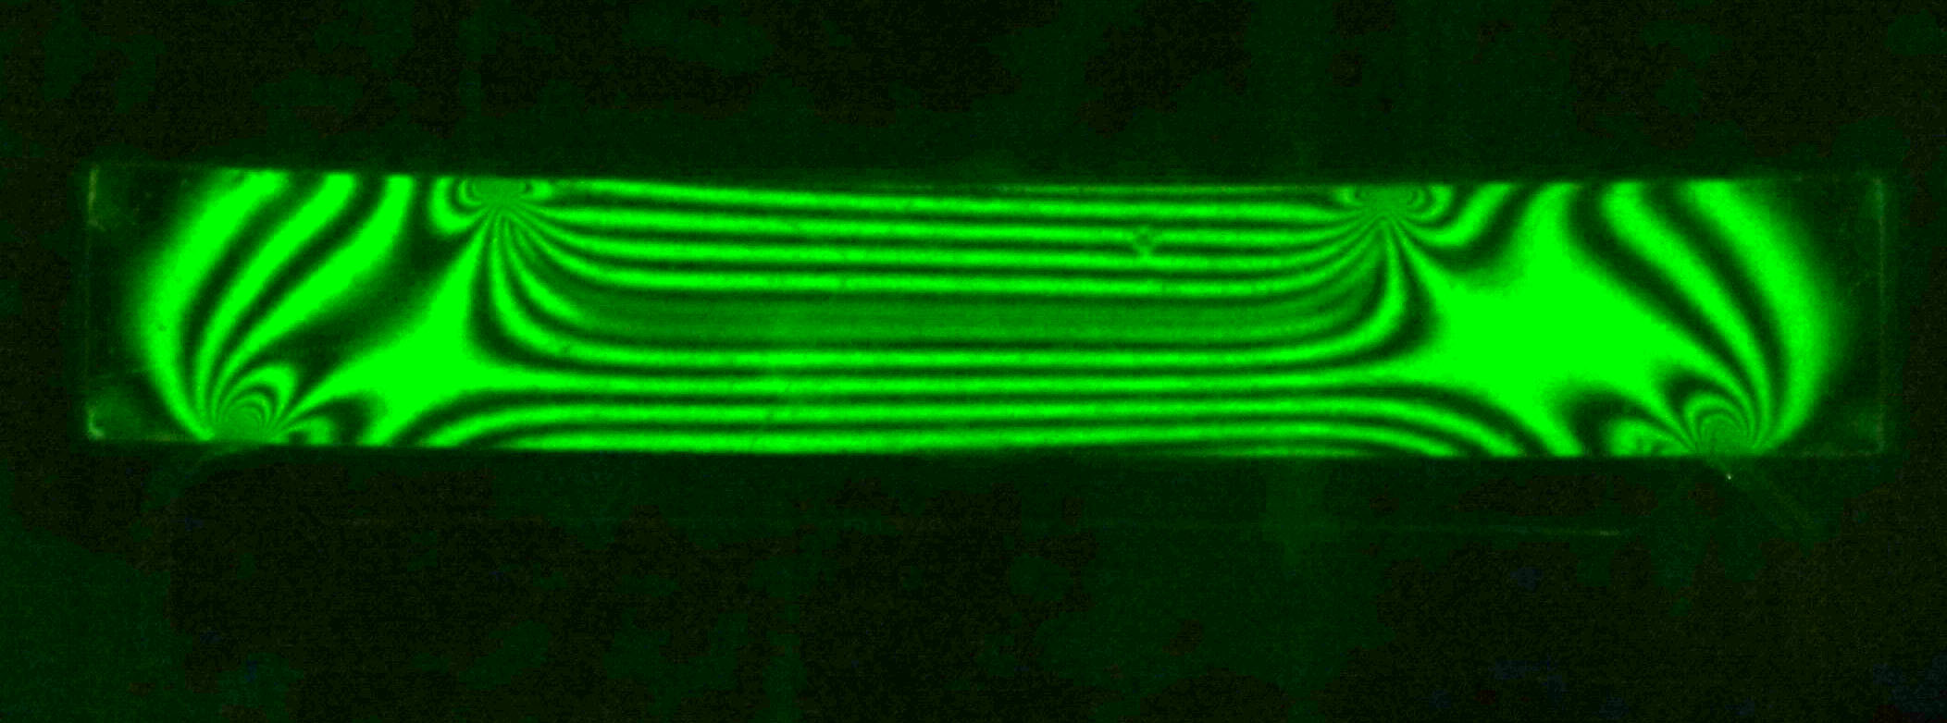
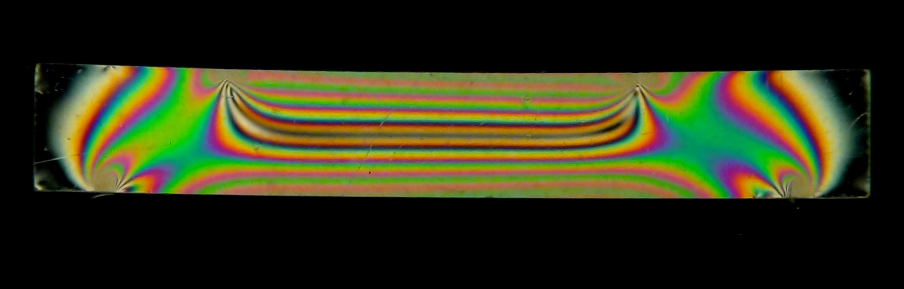
Photoelasticity

Slide 5
Publications in photoelasticity
Durelli, A.J., Chiang, F.P., et al., 1968. “Maximum stress at the angular corners of long strips bonded on one side and shrunk,” Experimental Mechanics, 8(6), pp. 278-281.
Durelli, A.J., Chiang, F.P., et al., 1969. “Stresses and strains in reinforced concrete,” J. Of the Structural Division, Proc. Of the Am. Soc. of Civil Engineers, 95 (ST5), pp. 871-887.
Durelli, A.J., Chiang, F.P., et al., 1970. “Strain and stresses in matrices with inserts,” Mechanics of Composite Materials, F. W. Wendt, H. Liebowitz and N. Perrone eds., Pergamon Press, pp. 265-336.
and Khetan, R.P., Chiang, F.P., 1974. “A new method to increase the sensitivity of photoelasticity,” Experimental Mechanics, 14(1), pp. 29-32.
Lu, H. and Chiang, F.P., 1993. “Photoelastic determination of stress intensity factor of an interfacial crack in a biomaterial,” J. Applied Mechanics 60, pp. 93-100.

Slide 6
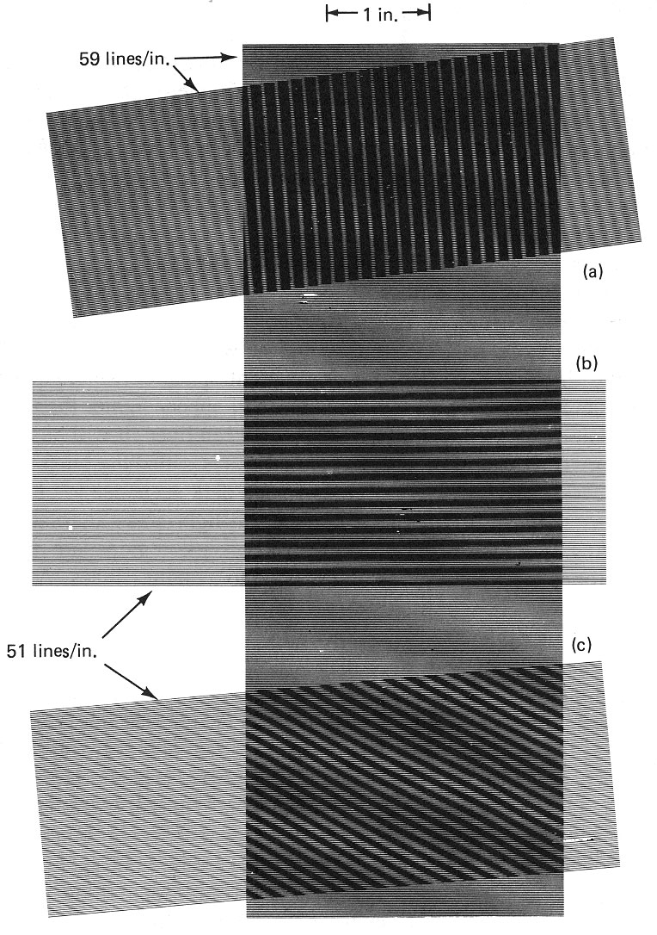
Moiré Patterns

Slide 7
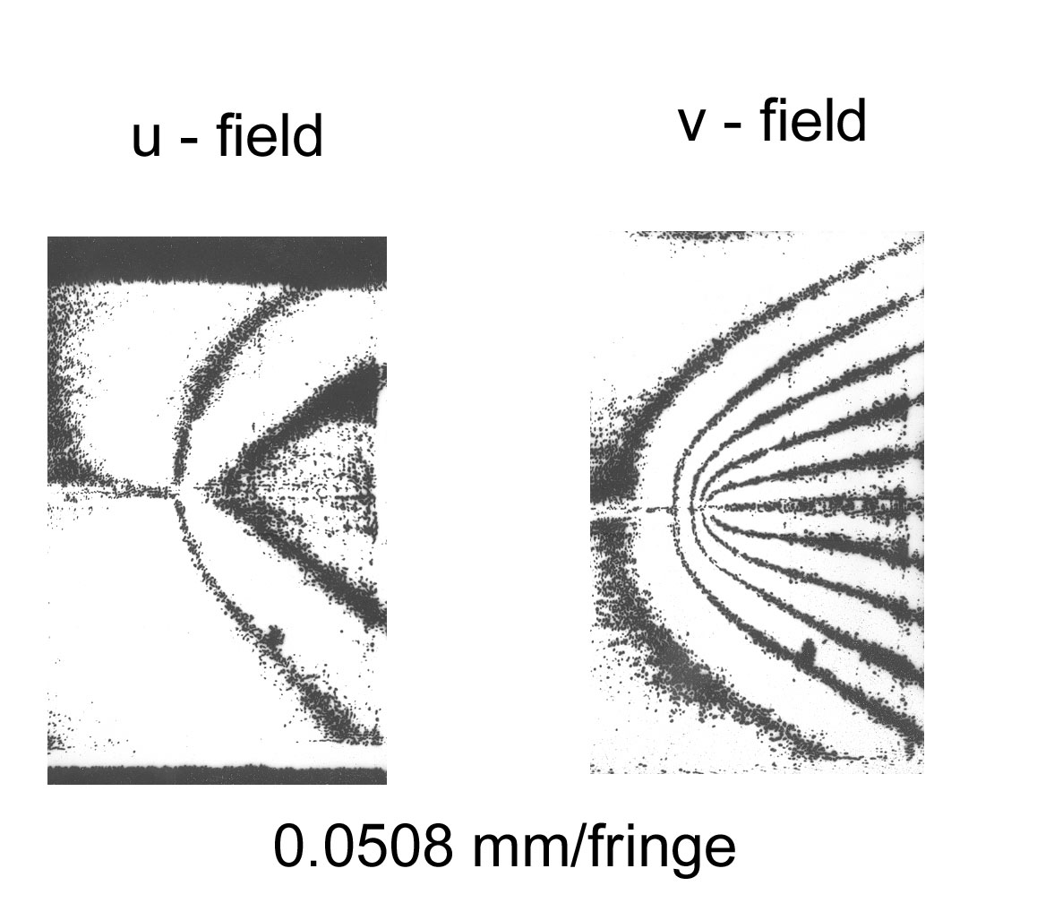
In-plane Moiré
Crack Tip Deformation
= NP
= MP
N,M= fringe order
P=grating pitch
Chiang, F.P., 1969. “Determination of signs in the moiré method,” Journal of Engineering Mechanics Division, Proc. of the Am. Soc. Civil Engineers, 95(EM6), pp. 1379-1391.
Chiang, F.P., 1972. “On a moiré method applied to the determination of two-dimensional dynamic strain distribution,” J. Applied Mechanics, Trans. of the ASME, 39(3), Series E., pp. 829-830.
Lin, C.J., and Chiang, F.P., 1982. “Time average in-plane moiré method for the analysis of general periodic loading,” Experimental Mechanics, 22(2), pp. 64-68.
Kin, C.C., and Chiang, F.P., 1983. “Some optical techniques of displacement and strain measurements on metal surfaces,” J. of Metals, pp. 49-54.

Slide 8
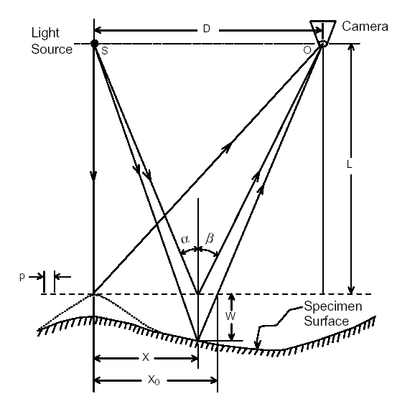

Shadow Moiré
Pirodda, 1969
Meadows et al., 1970
Takasaki, 1970
w$=\frac{NP}{tanαtanβ}$
Chiang, F.P., 1795. “A shadow moiré method with two discrete sensitivities,” Experimental Mechanics, 15(10), pp. 282-285.
Wei, S., Wu, S., Kao, I., and Chiang, F.P., 1998. “Measurement of Wafer Surface Using Shadow Moiré Technique with Talbot Effect”, ASME J. of Electronic Packaging, 120 (2), pp. 166-170.

Slide 9
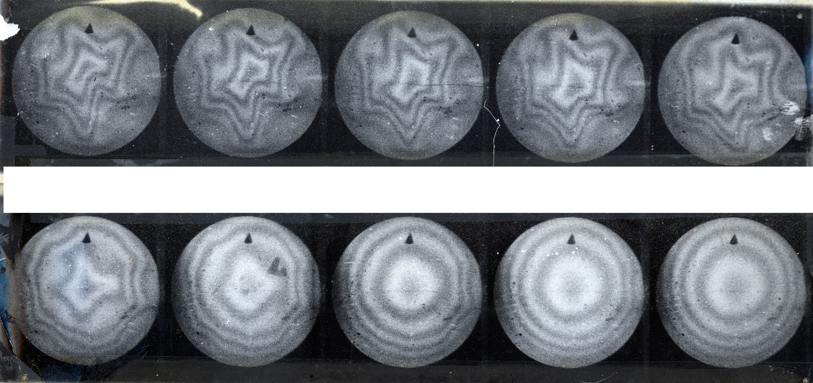
Dynamic Buckling of a Spherical Cap and Shock Pressure
Army Materials & Mechanics Research Center reports 1970s

Slide 10
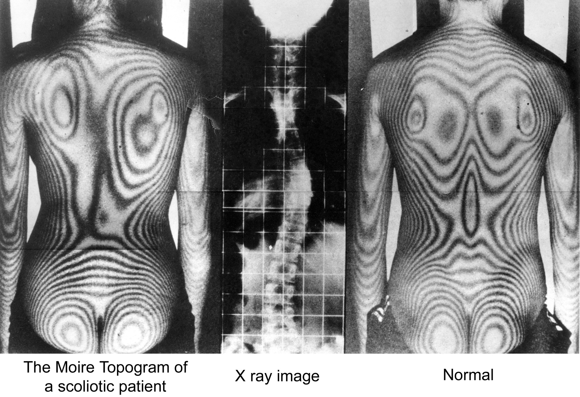
An interesting application of the shadow moiré method
Takasaki 1970

Slide 11
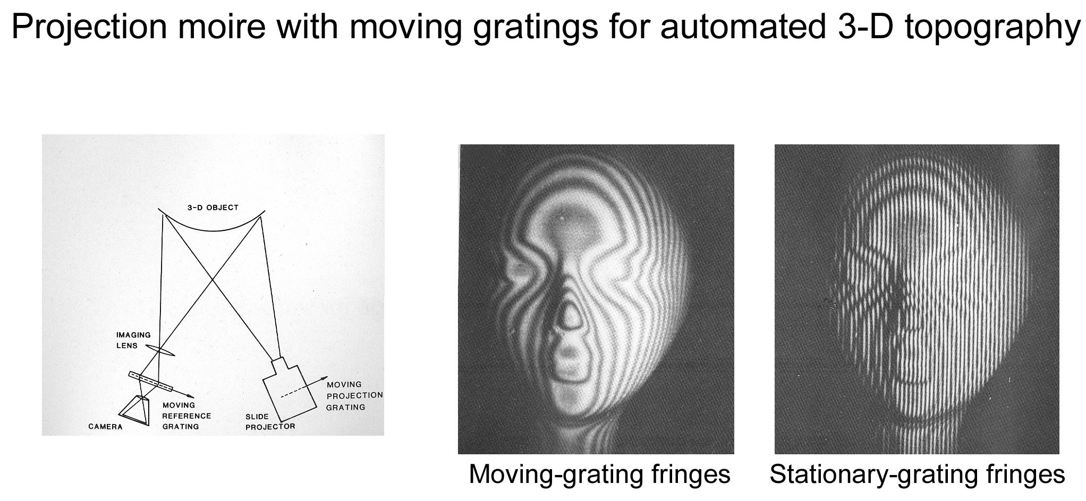
Projection Moiré
Halioua, M., Chiang, F.P., et al., 1983. “Projection moiré with moving gratings for automated 3D topography,” Appl. Opt., 22(6), pp. 850-855.

Slide 12
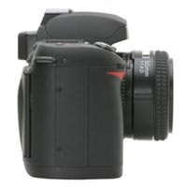

Reflection Moiré
Grating Projector
NP
2φ
NP
φ
Mirror Surface
Mirror Surface
P
a
b
Ligtenberg
Reflection Moiré Systems
Film
Schmodits
Lin, C.J., Chiang, F.P., 1979. “A time average reflection moiré method for vibration analysis of plates,” Applied Optics, 18(9), pp. 1424-1427.
Chiang, F.P., Faber, C., et al., 1971. “Two dimensional stress measurement in permalloy thin films by moiré method,” J. Applied Physics, 42(4), pp. 1422-1423.
Chiang, F.P., 1972. “A whole field method for the measurement of two-dimensional state of stress in thin films,” Experimental Mechanics, 12(8), pp. 277-379.

Slide 13
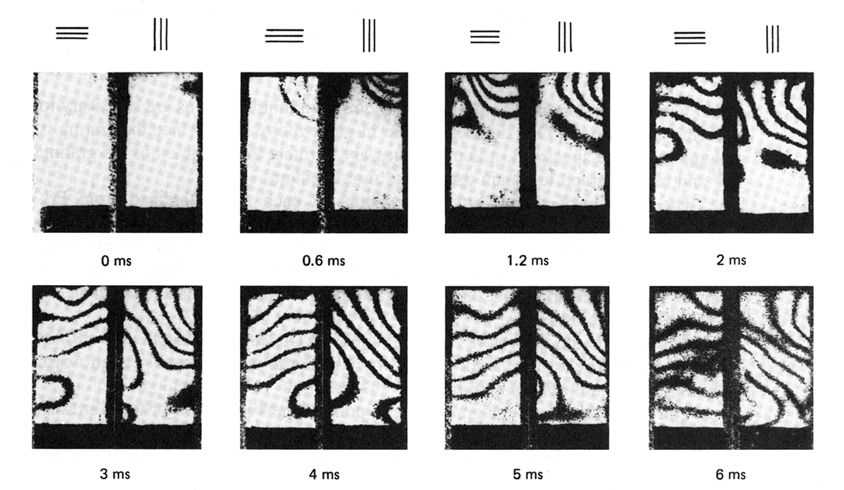
Reflection Moiré
Dynamic Bending of a Plate
Chiang, F.P., and Jaisingh, G., 1973. “Dynamic moiré methods for the bending of plates,” Experimental Mechanics, 1(4), pp. 168-171.
Chiang, F.P., 1969. “Techniques of optical spatial filtering applied to the processing of moiré fringe patterns,” Experimental mechanics, 6(11), pp. 5223-5226.

Slide 14


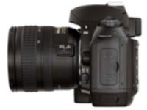
Refraction Moiré &
Moiré Deflectometry
Light
Grating
Grating
Grating
Camera
CGS (Coherent Gradient Sensor)
by Harresh Tippar

Slide 15
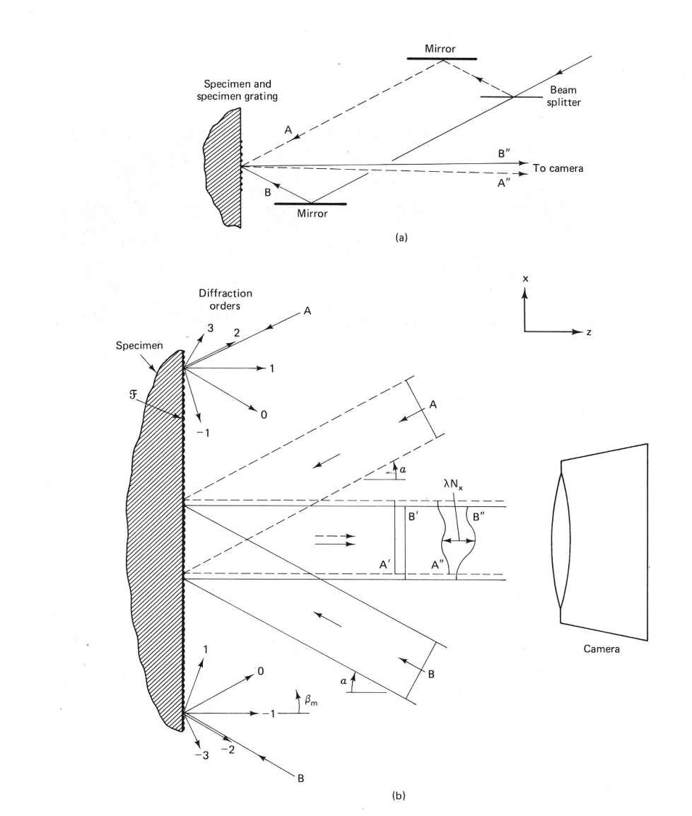
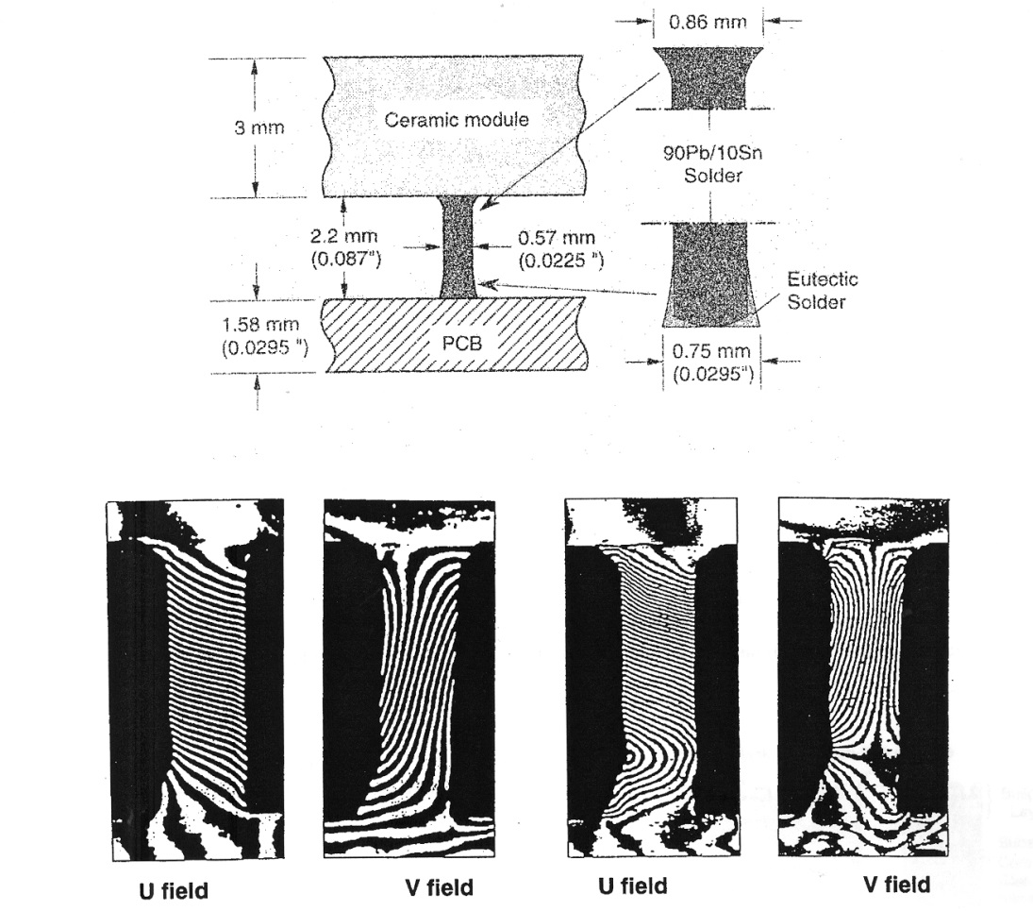
Moiré Interferometry
Han. B, 1997
Wang, Y.Y., and Chiang, F.P., 1997. “Experimental Study of Three-Dimensional Residual Stresses in Rails by Moiré Interferometry and Dissecting Method,” Optics & Lasers in Engineering, 27, pp. 89-100.
Kin, C.C., and Chiang, F.P., 1984. “A three-beam interferometric technique for the determination of strain on curved surface,” Optical Engineering, 23(6), pp. 766-768.

Slide 16
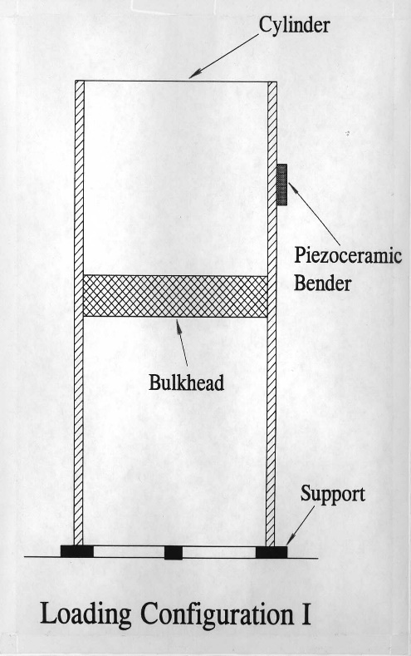
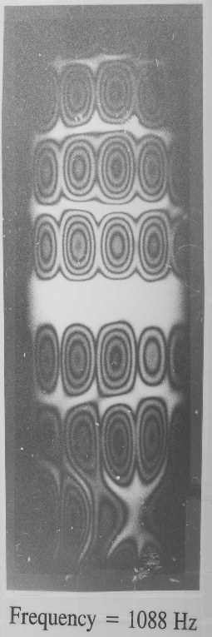
Holographic Interferometry
Beam Splitter
Object
Laser
Object Beam
Reference Beam
Hologram
General Dynamics Company Electric Boat Division

Slide 17
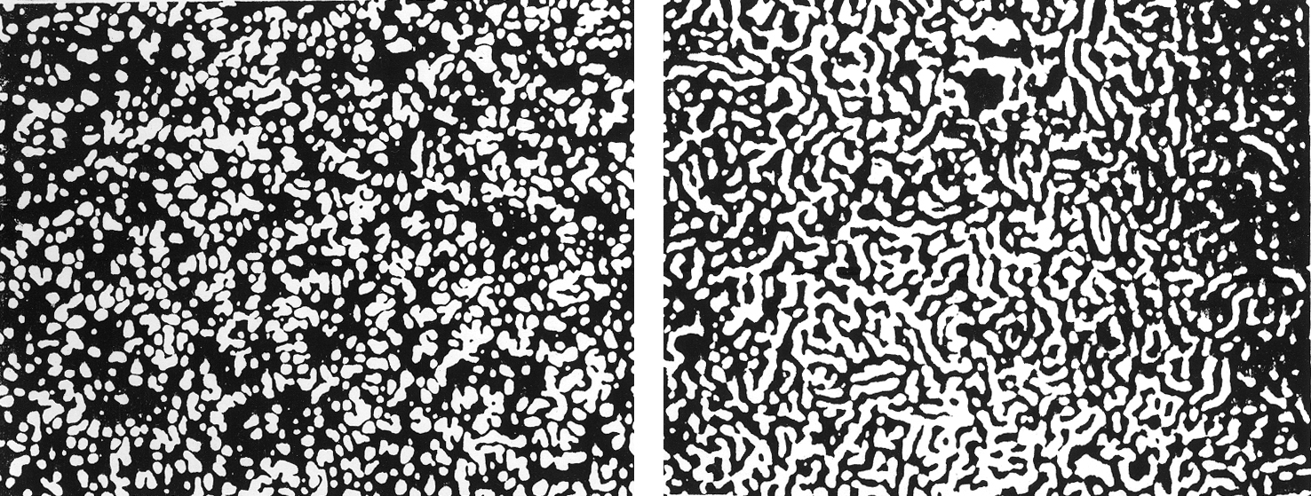
One Beam Laser Speckles

Slide 18
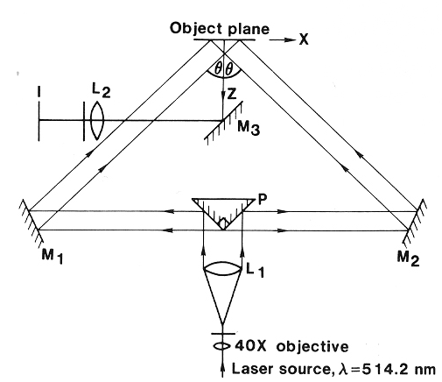
Two-Beam Laser Speckle Interferometry
Butters et al, 1977

Slide 19
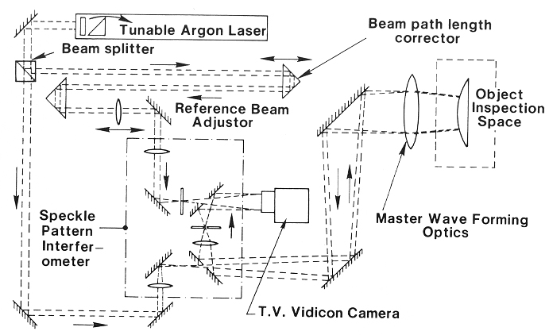
ESPI
(Electronic Speckle Pattern Interferometry)
Butters et al, 1977

Slide 20
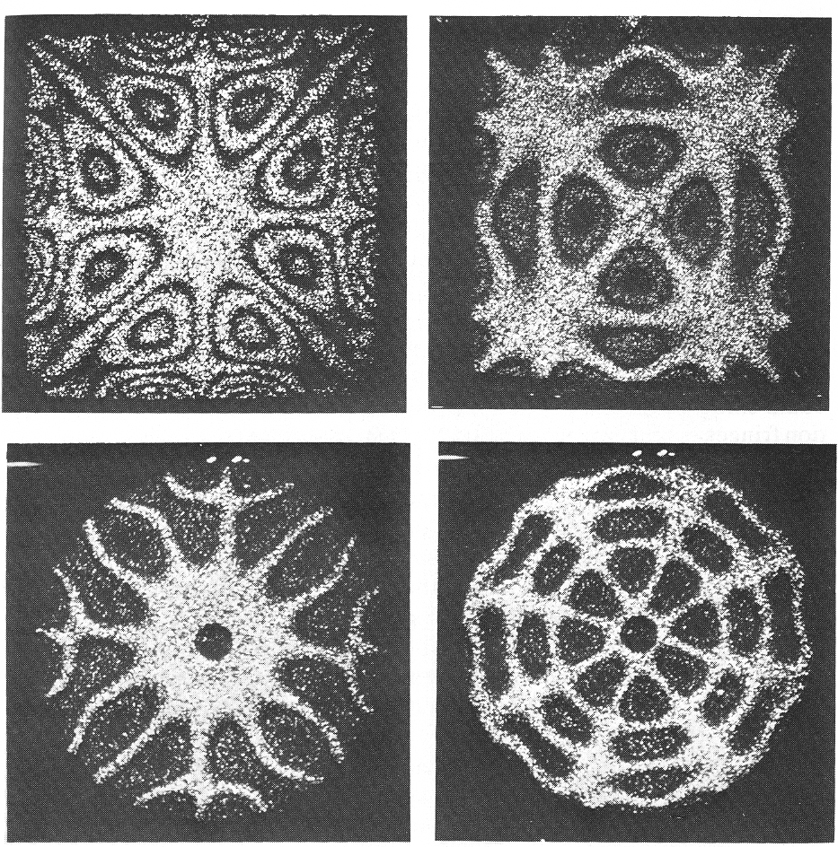
ESPI
(Electronic Speckle Pattern Interferometry)
Butters et al, 1977
Advanced work by C.C.M,C.Y.Chang, et. al

Slide 21
One-Beam Laser Speckle Interferometry
(Speckle Photography)
Laser Light
a= focused distance
When a = 0, in-plane laser speckle photography;
When a ≠ 0, defocused laser speckle photography
Camera
a
Focused plane
Optically Rough Surface

Slide 22
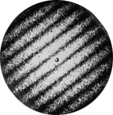
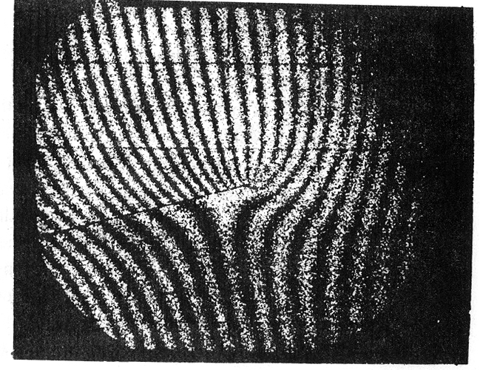
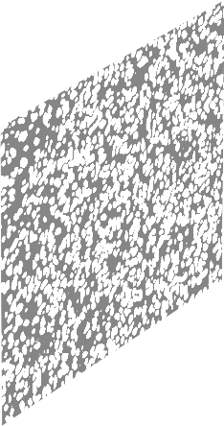
Processing of Specklegram
Pointwise Approach
Laser Beam
Double Exposure Specklegram
V-field Displacement Fringe Surrounding a Crack by One-beam Laser Speckle Photography
Full Field Approach
Aperture
Double Exposure Specklegram

Slide 23
Contributions to in-plane laser speckle photography
Khetan, R.P., Chiang, F.P., 1976. “Strain analysis by one-beam laser speckle interferometry I: single aperture method,” Applied Optics, 15(9), pp. 2205-2215.
Chiang, F.P., 1976. “A new three-dimensional strain analysis technique by scattered light speckle interferometry,” The Engineering Uses of Coherent Optics, E.R. Robertson ed., Cambridge University Press, pp. 249-262.
Li, D.W., Chiang, F.P., 1978. “Mapping in-plane stress waves in solids by laser speckles,” Mechanics Research Communications, 5(3), pp. 133-137.
Chiang, F.P., 1978. “Effect of magnification change in laser speckle interferometry,” J. of Optical Soc. of America, 68(12), pp. 1742-1748.
Khetan, R.P., Chiang, F.P., 1979. “Strain analysis by one-beam laser speckle interferometry II,” Applied Optics, 18(13), pp. 2178-2186.
Pedretti, M., Chiang, F.P., 1979. “On the lower limit of one beam laser speckle interferometry,” Optics and Laser Technology, 11(3), pp. 143-147.
Adachi, Chiang, F.P., et al., 1980. “Thermal strain measurement by one-beam laser speckle method,” Applied Optics, 19(16), pp. 2701-2704.
Lin, C.J., Chiang, F.P., 1980. “Stress analysis of in-plane vibration of 2D structure by a laser speckle method,” Applied Optics, 19(16), pp. 2705-2708.
Lin, C.J., Chiang, F.P., 1981. “Laser speckle method for the analysis of steady-state in-plane vibrations of plates,” J. of Acoustic Soc. of Am., 69(2), pp. 456-459
Adachi, J., Chiang, F.P., et al., 1982. “The subjective laser speckle method and its application of solid mechanics problems,” Opt. Eng., 21(3), pp. 379-380.
Chen, J.B., Chiang, F.P., 1984. “Statistical analysis of whole field filtering of specklegram and its upper limit of measurement,” J. of Optical. Soc. of Am., 1(8), 845-89.
Li, D.W., Chiang, F.P., 1985. “Statistical analysis of one-beam subjective laser speckle interferometry for displacement and strain analysis,” J. Opt. Soc. Am., 2(5), pp. 657-666.
Chen, J.B., Chiang, F.P., 1985. “An investigation of speckle field in a diffusing cylinder,” J. Opt. Soc. Am., 2(6), pp. 803-807.
Li, D.W., Chiang, F.P., 1985. “Diffraction halo functions of coherent and incoherent random speckle patterns,” Applied Optics, 24(4), 2166-2170.
Li, D.W., Chiang, F.P., 1986. “Laws of laser speckle movement,” Optical Engineering, 25(5), 667-670, May, 1986.
Li, D.W., Chiang, F.P., 1986. “De-correlation function in speckle photography,” J. Opt. Soc. Am., 3(7), 1023-1031.
Gupta, P.K., Chiang, F.P., 1989. “Laser speckle interferometry applied to studying transient vibrations of a cantilever beam,” J. Of Sound and Vibration, 133(2), 251-259.
Gupta, P.K., Chiang, F.P., 1990. “Resolution of resultant displacement into components in double exposure speckle photography,” Applied Optics, 29(11), 1642-1645.

Slide 24
Some fundamental studies of laser speckle and speckle photography
Chen, J.B., Chiang, F.P., 1984. “Statistical analysis of whole field filtering of specklegram and its upper limit of measurement,” J. of Optical. Soc. of Am., 1(8), 845-89.
Li, D.W., Chiang, F.P., 1985. “Statistical analysis of one-beam subjective laser speckle interferometry for displacement and strain analysis,” J. Opt. Soc. Am., 2(5), pp. 657-666.
Chen, J.B., Chiang, F.P., 1985. “An investigation of speckle field in a diffusing cylinder,” J. Opt. Soc. Am., 2(6), pp. 803-807.
Li, D.W., Chiang, F.P., 1985. “Diffraction halo functions of coherent and incoherent random speckle patterns,” Applied Optics, 24(4), 2166-2170.
Li, D.W., Chiang, F.P., 1986. “Laws of laser speckle movement,” Optical Engineering, 25(5), 667-670, May, 1986.
Li, D.W., Chiang, F.P., 1986. “De-correlation function in speckle photography,” J. Opt. Soc. Am., 3(7), 1023-1031.
Li, Q. B., and F. P. Chiang. "Three-dimensional dimension of laser speckle“. Applied optics 31.29 (1992): 6287-6291.

Slide 25
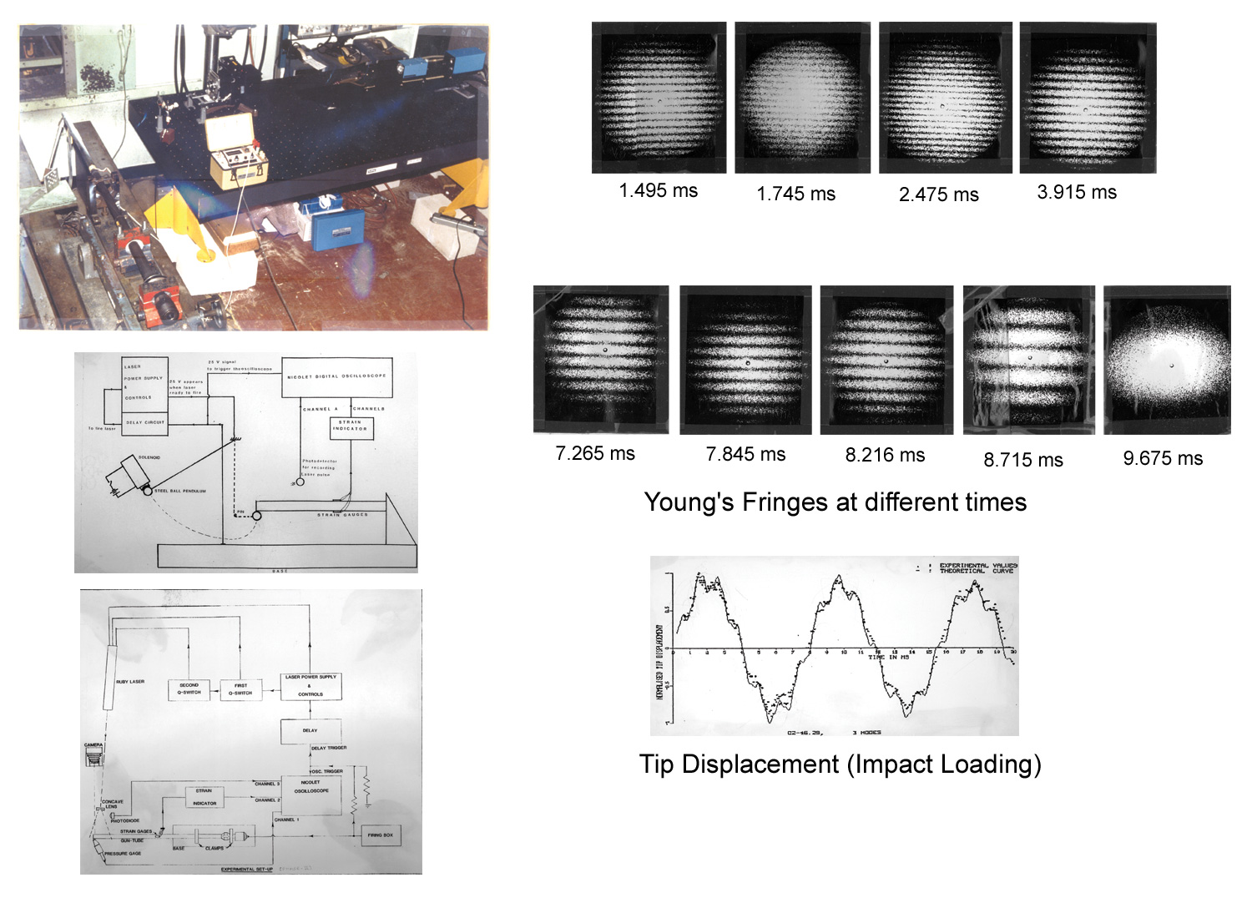
An interesting application of in-plane laser
speckle photography
Dynamic Oscillation of the Tip of a Cantilever Beam under Impact
Chiang, F.P., and Gupta, P.K., 1989. “Laser speckle interferometry applied to studying transient vibrations of a cantilever beam,” J. Of Sound and Vibration, 133(2), 251-259.

Slide 26
One-Beam Laser Speckle Interferometry
(Speckle Photography)
Laser Light
a= focused distance
When a = 0, in-plane laser speckle photography;
When a ≠ 0, defocused laser speckle photography
Camera
a
Focused plane
Optically Rough Surface

Slide 27
Contributions to defocused laser speckle photography
Chiang, F.P., 1976. “Laser speckle interferometry for plate bending problems,” Applied Optics, 15(9), pp. 2219-2204.
Juang, H., Chiang, F.P., 1976. “Vibration analysis of plates and shells by laser speckle interferometry,” Optica Acta, 23(12), pp. 997-1009.
Chiang, F.P., 1977. “Dynamic laser speckle interferometry applied to transient flexure problems,” Applied Optics, 15, pp. 2199-2200.
Lin, C.J., Chiang, F.P., 1980. “A Ligtenberg method for plate bending studies using laser speckles,” Mechanics Research Communications, 7(4), pp. 241-246.
Chin, K.C., Chiang, F.P., and Chang, W.B., 1981. “Time average laser specklegram of plate vibration using multi-aperture recording,” Appl. Opt., 20(7), pp. 1123-1124.
Jin, F., Chiang, F.P., 1997. “A New Technique Using Digital Speckle Correlation for Nondestructive Inspection of Corrosion”, Material Evaluation, 55(7), pp. 813-816.
Keene, L., and Chiang, F.P., 2009. “Real-time Anti-node Visualization of Vibrating Distributed Systems in Noisy Environments Using Defocused Laser Speckle Contrast Analysis,” Journal of Sound and Vibration, 320, pp. 472-481.

Slide 28
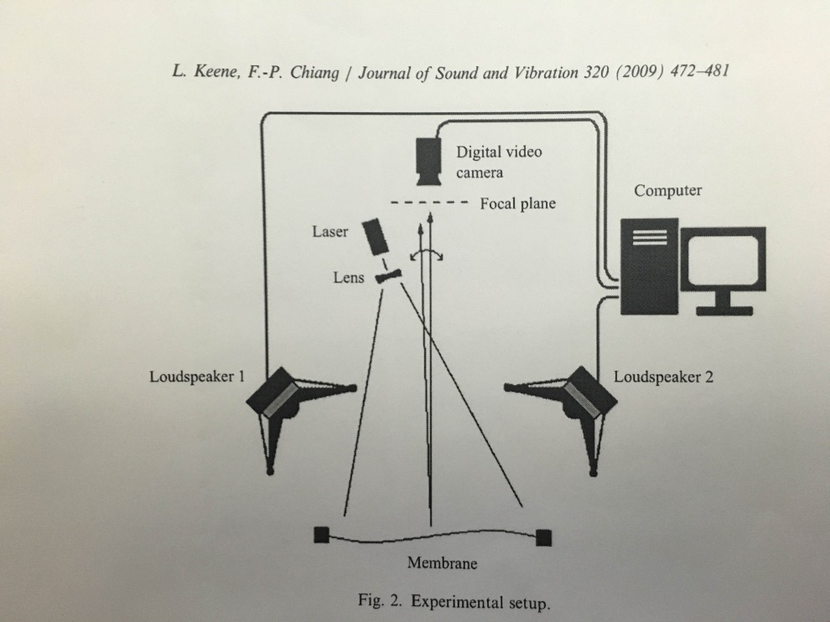
An interesting application of defocused laser speckle photography
Keene, L., and Chiang, F.P., 2009. “Real-time Anti-node Visualization of Vibrating Distributed Systems in Noisy Environments Using Defocused Laser Speckle Contrast Analysis,” Journal of Sound and Vibration, 320, pp. 472-481.

Slide 29
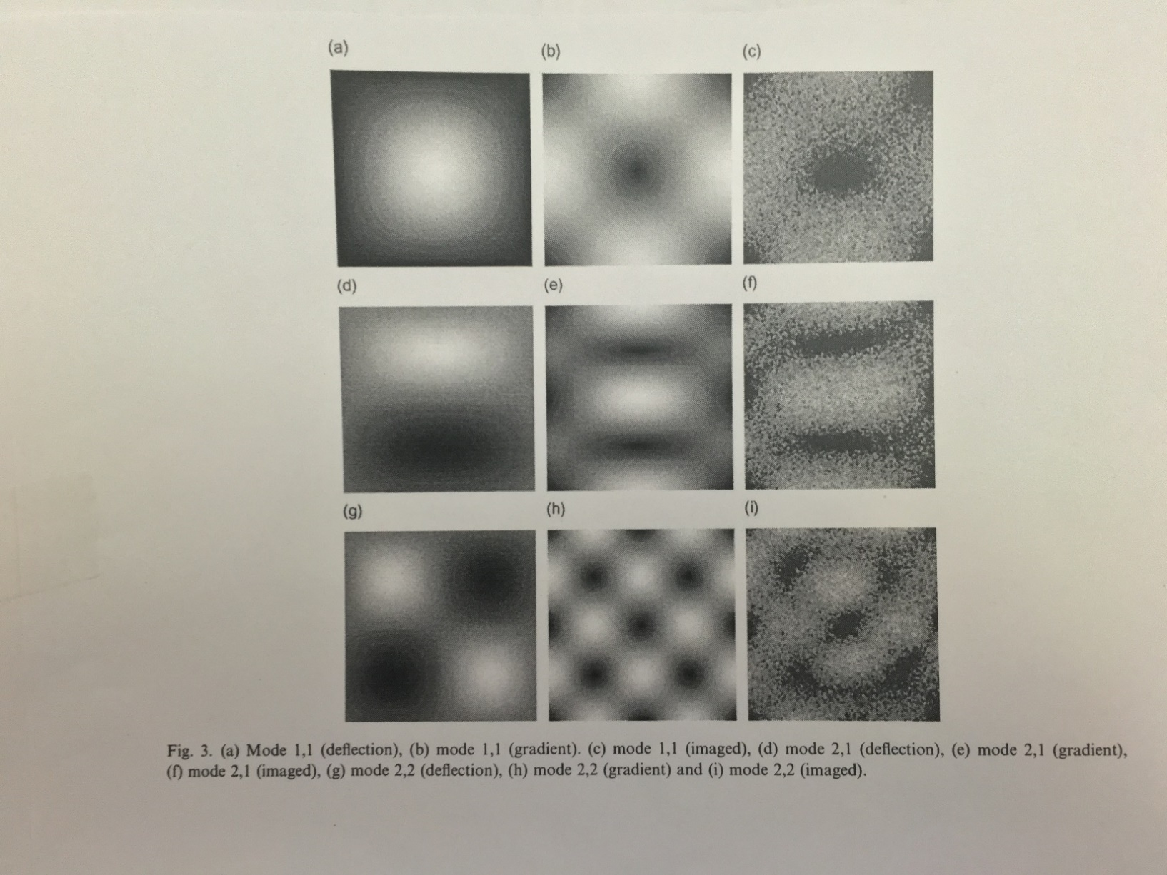

Slide 30
Objective laser speckle method of strain analysis
Laser beam
Kin, C.C., Chiang, F.P., 1982. “Strain Determination on curved surfaces using far-field objective laser speckles,” Opt. Eng., 21(3), pp. 444-446.
Kin, C.C., Chiang, F.P., 1983. “Objective laser speckle method for 3D displacement measurement on curved surfaces,” Opt. Engrg., 22(1), pp. 153-155.

Slide 31
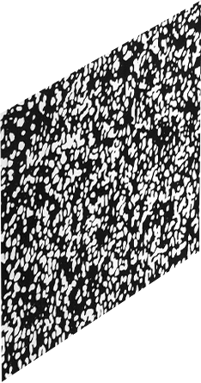
Incoherent Speckle Method
(White Light Speckle Method)
Camera
Surface with attached or natural speckles
Asundi, A., Chiang, F.P., 1979. “White light speckle method of experimental strain analysis,” Applied Optics., 18(4), pp. 409-11.
Asundi, A., Chiang, F.P., 1980. “Interior displacement and strain measurement using white light speckles,” Applied Optics, 19(4), pp. 2152-2256.
Bailangadi, M.N., Chiang, F.P., 1980. “White light projection speckle method for generating deflection contours,” Applied Optics, 19(15), pp. 2623-2626.
Bailangadi, M.N., Chiang, F.P., 1981. “General analysis of the projection speckle method,” Applied Optics, 20(9), pp. A90-A91.
Asundi, A., Chiang, F.P., 1982. “Measurement of large deformation using the white light speckle method,” Mechanics Research Communication, 9(5), pp. 325-330.
Asundi, A., and Chiang, F.P., 1982. “Theory and application of white light speckle methods,” Optical Engineering, 21(4), pp. 570-580.
Wu, X.P., and Chiang, F.P., et al., 1985. “Chromatic speckle: its characteristics and applications,” Proc. OSA 1985 Annual Meeting, Washington, D.C., Oct. 14-18, 1985, (Abstract).

Slide 32
Digital Speckle Photography :
Digital Recording and Digital Processing Using CASI (Computer Aided Speckle Interferometry)
Digital Specklegram
Before Deformation
U : Displacement
Component along
x-axis
Digital Specklegram
After Deformation
V : Displacement
Component along
y-axis

Slide 33
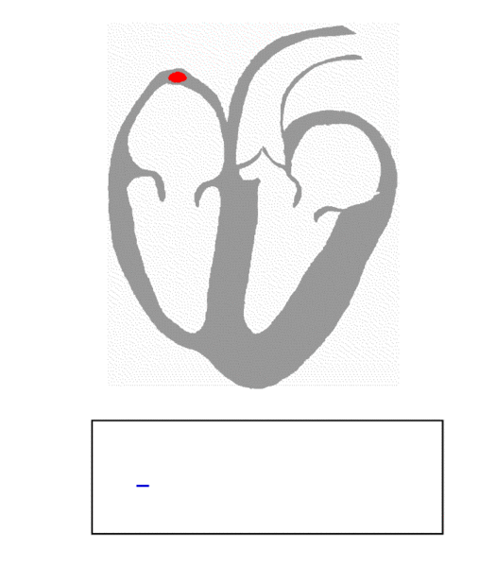
Contracting Heart

Slide 34
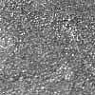
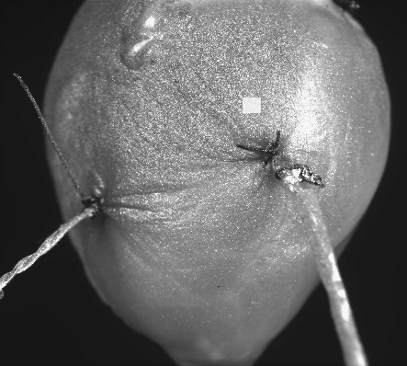
Validation of CASI as a Measuring Technique for Myocardial Deformation
Area of
Area of
Adjustable pressure
interest
Adjustable pressure
interest
head from water
head from water
CCD
Computer
CCD
Computer
90 pixels
1 mm
90 pixels
1 mm
90 pixels
1 mm
90 pixels
1 mm

Slide 35
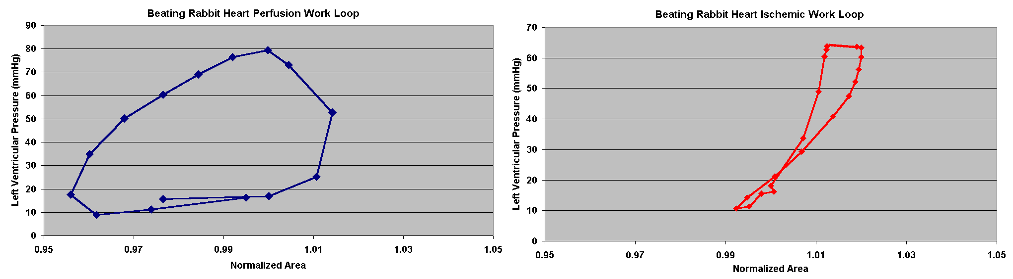
Non-ischemic vs. Ischemic Work Loops Determined by CASI

Slide 36
Contributions to Heart Mechanics:
Gaudette, G.R., Todaro, J., Krukenkamp, I.B., and Chiang, F.P. 1999. “A Novel Technique for Measuring Epicardial Deformation with High Spatial Resolution” Biophysical Journal 76(1), pp. A309.
Gaudette, G.R., Azeloglu, E.U., Oleszak, L., Saltman, A.E., Krukenkamp, I.B., and Chiang, F.P. 2002. “Determination of Regional Area Stroke Work with High Spatial Resolution in the Heart”, Cardiovascular Engineering, 2(4), pp. 129-137.
Chiang, F.P., Gaudette, G.R., Todaro, J., Keene, J., and Krukenkamp, I.B. 2002. “The Application of Speckle Metrology to the Heart”, Recent Advances in Experimental Mechanics, E.E. Gdoutos (Ed.) Kluwer Academic Publishers.
Gaudette, G.R., Lense, M., Todaro, J., Azeloglu, E.U., Oleszak, L., Saltman, A.E., Krukenkamp, I.B., and Chiang, F.P. 2004. “Effects of Eschemia on Epicardial Deformation in the Passive Rabbit Heart”, J. of Biomech Eng 126(1), pp. 70-75.
Chiang, F.P., Qin, Y.X., McLeod, K.J., and Guilak, F. 2005. “Correlation of Bony Ingrowth to the Distribution of Stress and Strain Parameters Surrounding a Porous-Coated Implant”, J. Orthopedics Research 14, pp. 862-870.
Chiang, F.P., Gaudette, G.R., Yun, Y., Azeloglu, E.U., Chen, W., Saltman, A.E., and Krukenkamp, I.B. 2006 “High Resolution Mechanical Function in the Intact Porcine Heart: Mechanical Effects of Pacemaker Location”, J. Biomechanics, 39, pp. 717-725.

Slide 37
Electron Speckle Photography (ESP) Technique
● laser and white light speckle technique have resolution limits, λ=wavelength of visible light, ~0.5 micro
●Speckle size = 1.2λF
λ: wavelength, F = f/number of lens aperture
● Using electron speckle photography extends the resolution into nanometer region.

Slide 38
Electron Speckle Photography (ESP)
Procedure
Creating micro/nano particles on specimen surface which are used as gauging devices to map the full field deformation.
Recording and digitizing speckle patterns using an electron microscope.
Analyzing speckle images by CASI (Computer Aided Speckle Interferometry)

Slide 39
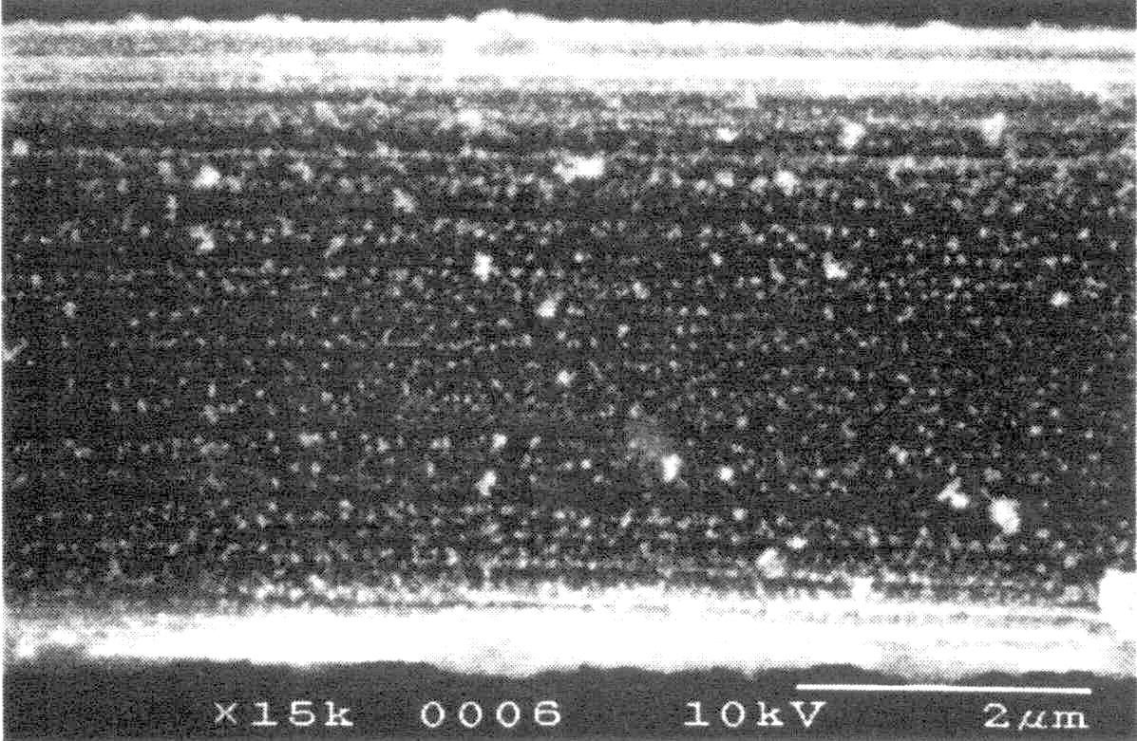
Submicron Speckle Pattern on a Strand of Graphite
as recorded by SEM

Slide 40
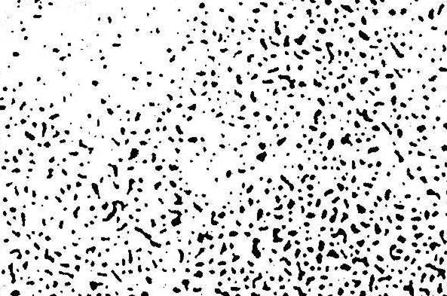
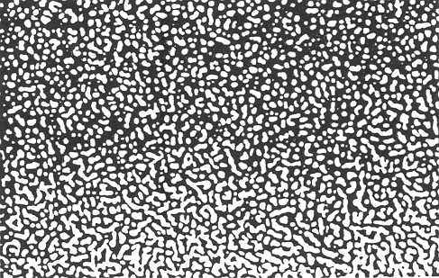
Typical Electron Speckle Photography Pattern
1µm
Observed by SEM
5nm
Observed by TEM

Slide 41
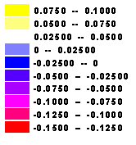
Examples of ESP crack tip residual strain distribution in steel
1,000 cycles
1,500 cycles
2,000 cycles
Electron Speckle Photography

Slide 42
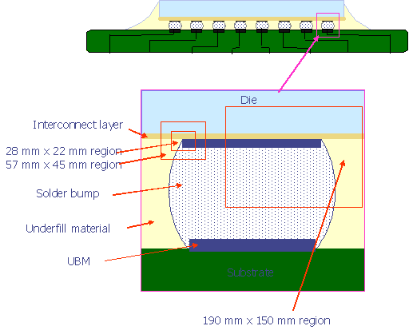
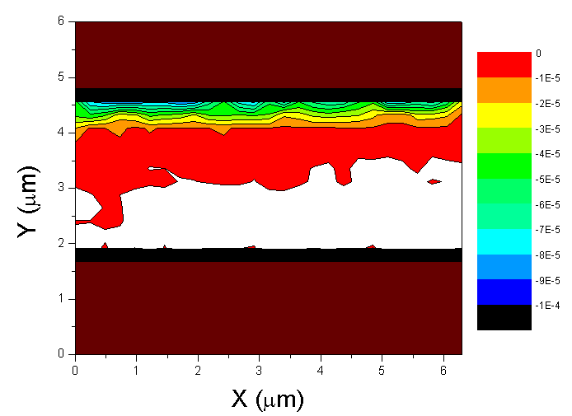
Application to Thermal Strain Determination in Electronic Packaging
Testing Regions of Cu-Si3N4
V field at ΔT = 188ºC
Project from Motorola Inc.

Slide 43
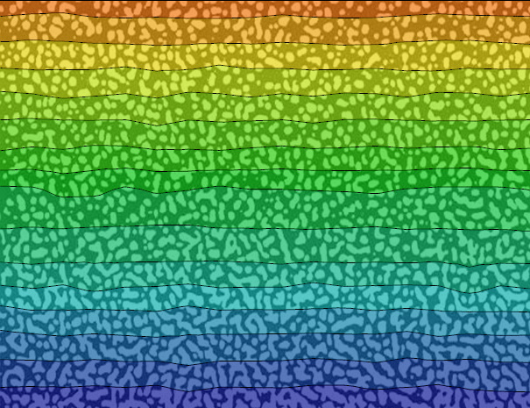
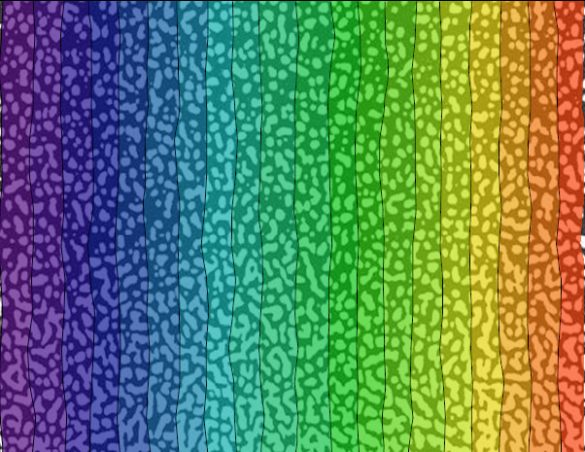
v field
u field
v and u displacement fields after a virtue stretch of the image
both in vertical and horizontal directions
The displacement contour interval is 0.04 nm.

Slide 44
Publications on facture mechanics
Chiang, F.P., and Williams, R. 1984. “Transient strain fields of ductile fracture of a centrally cracked aluminum sheet,” Modeling Problems in Crack Tip Mechanics, G. Sih et al eds., Martinus Nijhoff Publishers, Boston, pp. 345-35.
Chiang, F.P., Williams Jr., R.C. 1985. “Simultaneous generation of 3D displacement contours of fracturing specimen using moiré,” Eng. Fracture Mech. 22(5), pp. 731-735.
Chiang, F.P., Wu, X.P. 1986. “Three-dimensional crack tip deformation of plastically deformed 3-point bend specimens,” Proc. 19th National Symposium on Fracture Mechanics, San Antonio, TX, June 30-July 2, 1986.
Chiang, F.P., and Hareesh, T.V. 1988. “Integrated experimental-finite element approach for studying elasto-plastic crack-tip fields,” Eng. Fracture Mechanics, 31(3), pp. 451-461.
Chiang, F.P., and Hareesh, T.V. 1988. “Three-dimensional crack tip deformation, an experimental study and comparison to HRR field,” Int. J. of Fracture 36, pp. 243-257.
Chiang, F.P., Liu, B.C. 1990. “Crack tip parameters and elastic-plastic Deformation of metals,” Int. J. of Fracture 42, pp. 371-388.
Chiang, F.P., and Lu, H. 1990. “Surface & Interior Stress Intensity Factor Measurement by a Random Speckle Method,” Int. J. Fracture 43, pp. 185-194.
Chiang, F.P., and Liu, B.C. 1990. “Crack tip parameters and elastic-plastic fracture of metals,” Int. J. of Fracture 42(4), pp. 371-388.
Chiang, F.P., and Li, S. 1990. “Optical analysis of ductile fracture of metals,” Proc. Conf. on Applied Stress Analysis, Nottingham, U.K., Aug. 30-31, 1990.
Chiang, F.P., and Hareesh, T.V. 1991. “Analysis of Combined Moiré & Laser Speckle Grating Methods Used in 3-D Crack Tip Deformation Measurements,” Applied Optics 30(19), pp. 2478-2756.
Chiang, F.P., and Dai, Y.Z. 1991. “Scattering from plastically roughened surface and its applications to strain assessment,” Optical Engineering 30(9), pp. 1269-1276.
Chiang, F.P., Dai, Y.Z., and Kato, A. 1991. “Fatigue monitoring by laser speckle,” Int. J. of Fatigue 13(3), pp. 227-232.
Chiang, F.P., Li, X.M. 1992. “Experimental study of creep crack growth in coarse-grained aluminum” Engineering Fracture Mechanics 434(5), pp. 837-846.
Chiang, F.P., Li, X.M., Wu, J., Dudley, M. 1992. “Experimental measurement of the crack tip strain field in a single crystal,” Engineering Fracture Mechanics 43(2), pp. 171-184.
Chiang, F.P., Li, S., and Wang, Y.Y. 1992. “Experimental study of near-crack-tip deformation fields,” ASTM STP 1131, Atlurri et al., Eds, 225-244, ASTM, Philadelphia, PA 1992.
Chiang, F.P., Wang, Y.Y., Barsoum, R.S., and Chou, S.C. 1993. “Study of deformation field of interface crack in an adhesive joint,” Engineering Fracture Mechanics 44(2), pp. 175-184.
Chiang, F.P., and Lu, H. 1993. “Photoelastic determination of stress intensity factor of an interfacial crack in a biomaterial,” J. Applied Mechanics 60, pp. 93-100.
Chiang, F.P., and Du, M.L. 1998. “The Effect of Static Tensile Strain on Fatigue Failure”, International Journal of Fatigue 20(5), pp. 331-338.

Slide 45
Three Dimensional Stress/Strain Analysis Techniques
The Holy Grail of Experimental Mechanics Community: a powerful 3D stress/strain measurement technique that can probe the internal deformation field of opaque solids

Slide 46
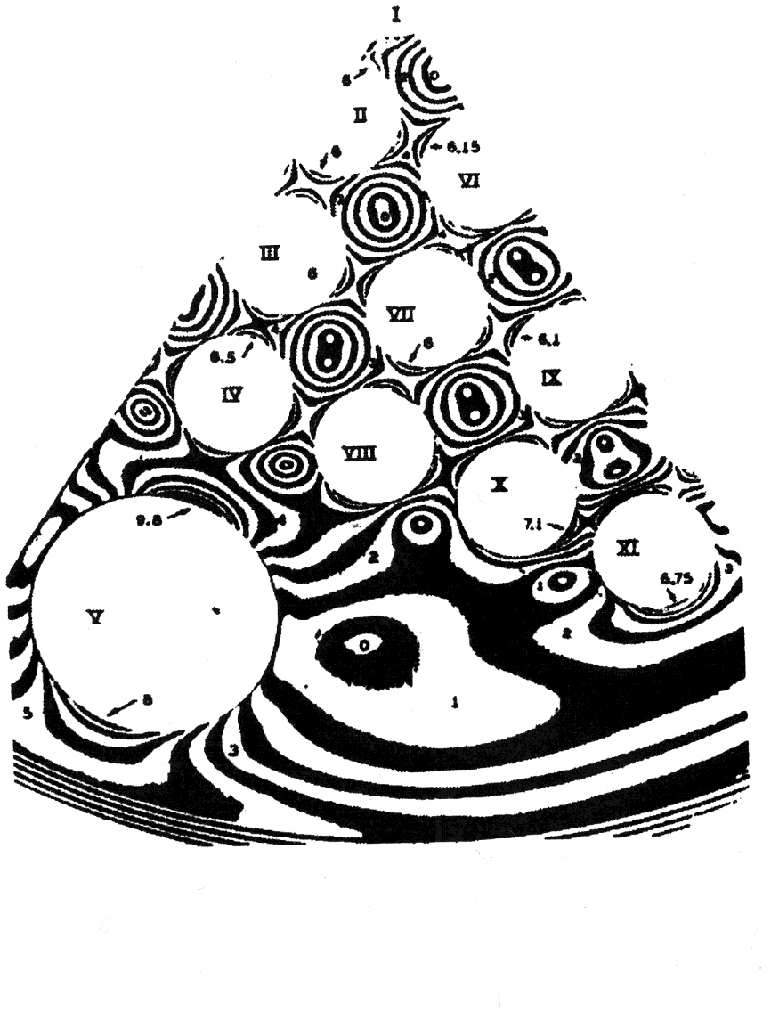
Frozen Stress Photoelasticity-The Most Widely Used 3D Stress Analysis Technique
Experimental Solid Mechanics A. Shukla & J. W. Dally P.346

Slide 47
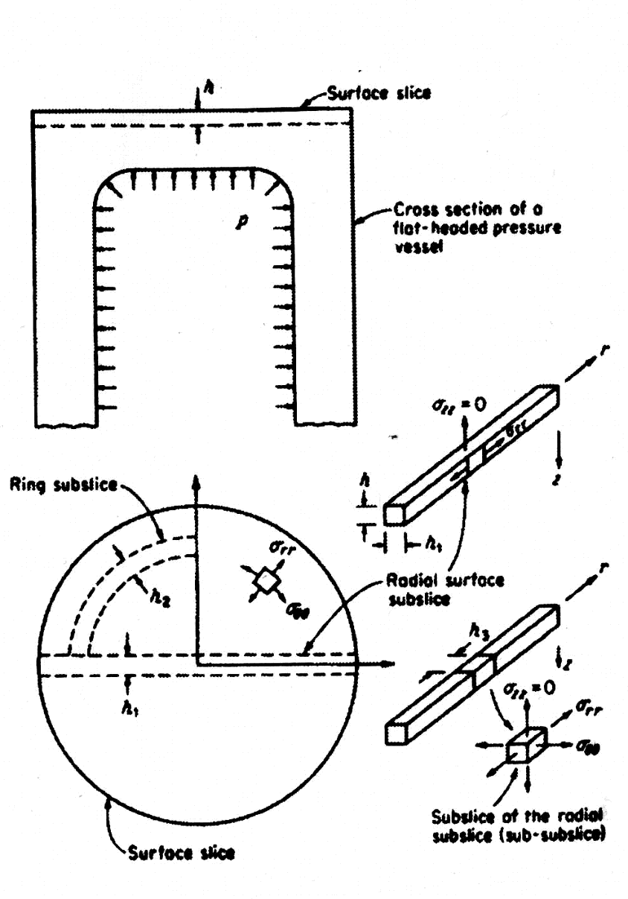
Slicing and Cutting in Order to Obtain the Stress at a Point
Experimental Solid Mechanics A. Shukla & J. W. Dally P.346

Slide 48
Digital Volumetric Speckle Photography (DVSP):
a New 3D Strain Analysis Technique for Opaque Solids

Slide 49
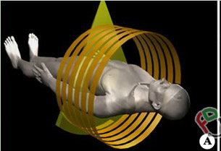
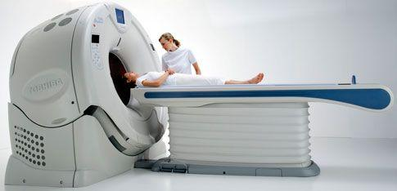
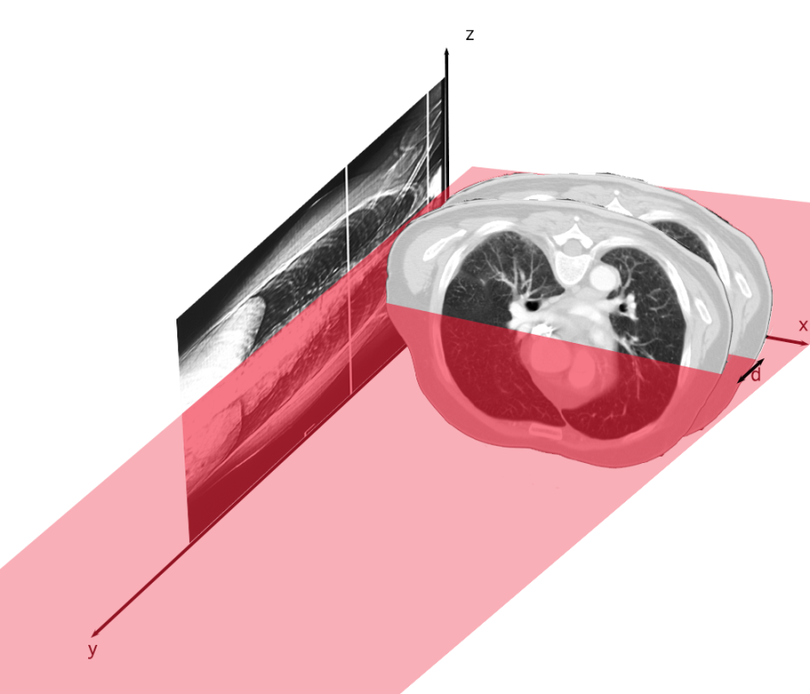
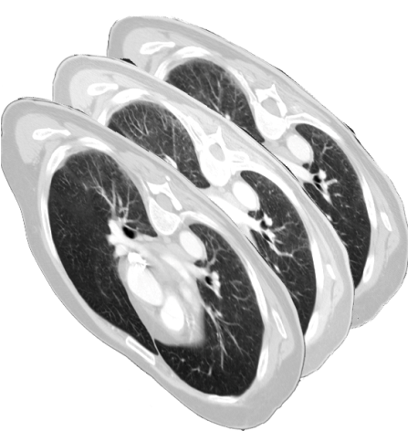
Theory of X-ray Computed Tomography
Medical X-ray Computed Tomography

Slide 50
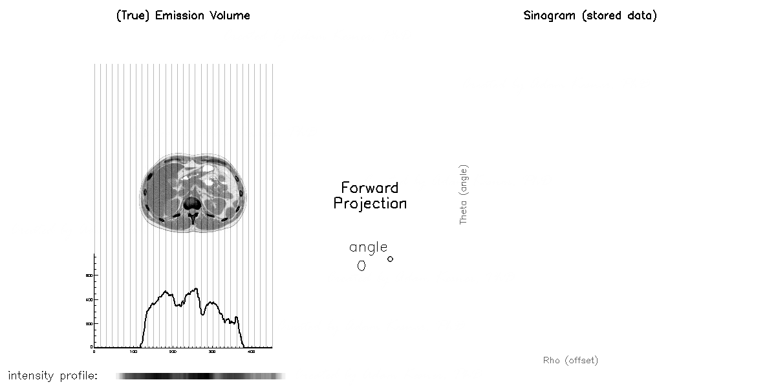
Theory of X-ray Computed Tomography
X-ray Computed Tomography -Image Reconstruction

Slide 51
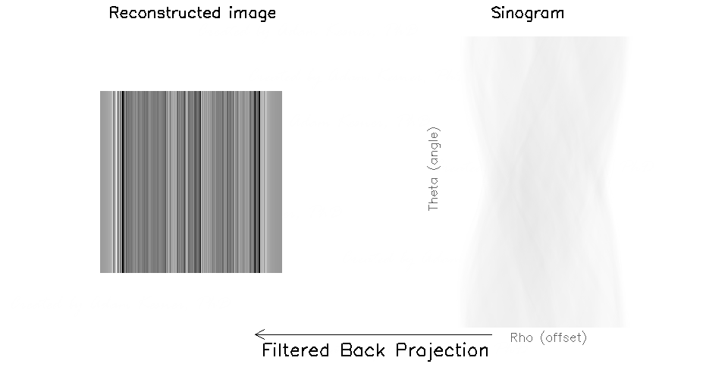
Theory of X-ray Computed Tomography
X-ray Computed Tomography- Image Reconstruction

Slide 52
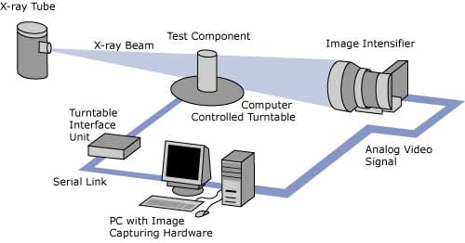
Principle of Industrial X-Ray Computed Tomography
Industrial X-ray CT

Slide 53
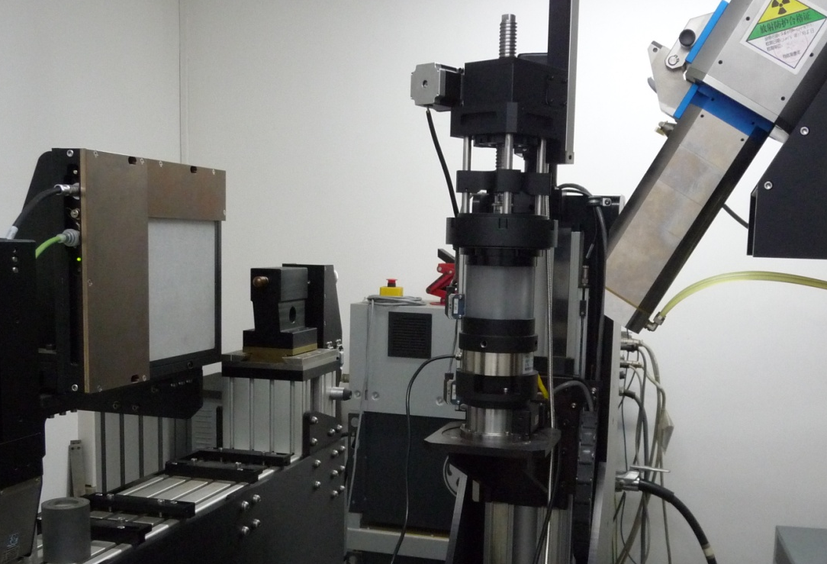
Hardware of Industrial X-Ray Computed Tomography
CT System and Loading Setup
Microfocus x-ray resource from YXLON (FeinFocus FXE-225.48, size of focus:3 × 6 micron)
Motorized rotation stage from Newport
X-ray detector unit (1024×1024 pixels) from PerkinElme (XRD 0822AP 14)
Loading Cell is made of Polycarbonate
Detector
Loading setup
X-ray resource
Rotation stage

Slide 54
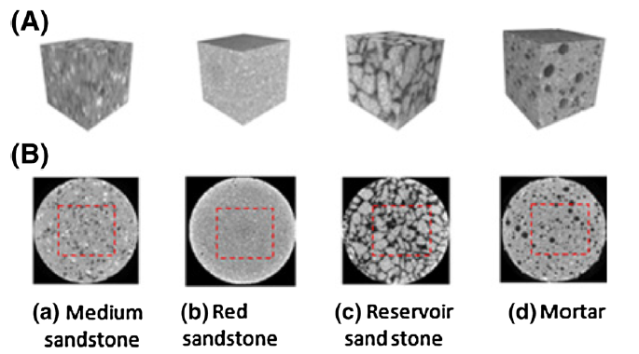
Typical Volumetric Speckles
Volumetric Speckles in Rocks due to impurity and voids
(A) Cropped volume image (B) Cross-section of a cylinder

Slide 55
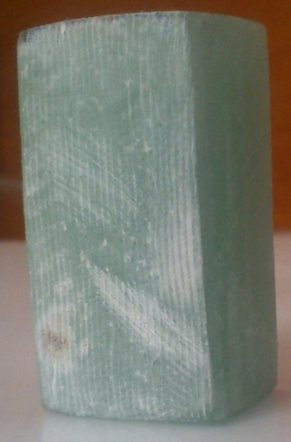


Any 3D Markings can be Considered as Speckles
3D Speckle structure in a fiber reinforced composite
Specimen from a windmill blade by conventional photography
Cropped from reconstructed
CT image
Three orthogonal cross sections

Slide 56

Principle of 2D Digital Speckle photography (DSP)
Schematics demonstrating the processing algorithm of CASI

Slide 57




Principle of 3D DSP or DVSP
Digital Volumetric Speckle Photography(DVSP)
z
y
ζ
x
η
3D FFT
First spectral domain
ξ
Second spectral domain
3D FFT
Reference Volume image
Segmentation
Subset
=
Crest
G(ξ,η,ζ)
3D FFT
Deformed Volume image
Segmentation
Subset
(u,v,w) indicates the displacement of subset

Slide 58


Application of DVSP to Composites
Internal strain analysis of a composite beam under 3-point bending
F
y
x
z
⑩
⑨
y/mm
⑧
⑦
Load/N
⑥
④
⑤
③
z/mm
x/mm
②
①
F=10.5kN
Displacement/μm
Lingtao Mao, Fu-pen Chiang, Interior Strain Analysis of a Woven Composite Beam Using X-ray Computed Tomography and Digital Volumetric Speckle Photography, Composite Structures, 2015,134:782-788

Slide 59




Application of DVSP to Composites
Internal strain analysis of a composite beam under 3-point bending
μm
μm
u field
F=10.5kN
y/mm
y/mm
z/mm
x/mm
z/mm
x/mm
μm
μm
y/mm
y/mm
z/mm
x/mm
z/mm
x/mm

Slide 60




Application of DVSP to Composites
Internal strain analysis of a composite beam under 3-point bending
μm
μm
v field
F=10.5kN
y/mm
y/mm
z/mm
x/mm
z/mm
x/mm
μm
μm
y/mm
y/mm
z/mm
x/mm
z/mm
x/mm

Slide 61




Application of DVSP to Composites
Internal strain analysis of a composite beam under 3-point bending
μm
μm
w field
F=10.5kN
y/mm
y/mm
z/mm
x/mm
z/mm
x/mm
μm
μm
y/mm
y/mm
z/mm
x/mm
z/mm
x/mm

Slide 62




Application of DVSP to Composites
Internal strain analysis of a composite beam under 3-point bending
ε_{xx} field
F=10.5kN
y/mm
y/mm
z/mm
x/mm
z/mm
x/mm
y/mm
y/mm
z/mm
x/mm
z/mm
x/mm

Slide 63




Application of DVSP to Composites
Internal strain analysis of a composite beam under 3-point bending
ε_{yy} field
F=10.5kN
y/mm
y/mm
z/mm
x/mm
z/mm
x/mm
y/mm
y/mm
z/mm
x/mm
z/mm
x/mm

Slide 64




Application of DVSP to Composites
Internal strain analysis of a composite beam under 3-point bending
ε_{xy} field
F=10.5kN
y/mm
y/mm
z/mm
x/mm
z/mm
x/mm
y/mm
y/mm
z/mm
x/mm
z/mm
x/mm

Slide 65



Applications of DVSP
Internal Strain Analysis of Red Sandstone
z
y
x
⑦
F
⑥
⑤
Axial Stress/MPa
④
Calculation Area
⑧
50
36
③
②
①
F
POF Filter
Axial Strain
Stress-strain curve
Lingtao Mao, Jianping Zuo, Zexun Yuan, Fu-Pen Chiang, Full-field mapping of internal strain distribution in red sandstone specimen under compression using digital volumetric speckle photography and X-ray computed tomography, Journal of Rock Mechanics and Geotechnical Engineering,2015, 7 (2015): 136-146
Section image along x=12.5mm

Slide 66








Applications of DVSP
Internal Strain Analysis of Red Sandstone
  Von Mises equivalent strain
Volumetric strain
με
με
mm
mm
mm
mm
mm
mm
(a)
(b)
(c)
(a)
(b)
(c)
(a) 7.97MPa (Step5); (b) 10.19MPa(Step6); (c) 11.98MPa (Step7)
The onset of strain localization started at the lower left corner and propagated upward as indicted by the dotted lines in Fig.(d), (e), (f) . At the same time, the volumetric strain also increased.

Slide 67


Application of DVSP
Internal Deformation Analysis of Coal Caused by CO₂ Sorption
Strain gage
Scanning Area
25mm
Coal sample
Size: Φ25 ×50mm
Sealed container cell
Lingtao Mao, Nai Hao, Liqian An ,Fu-pen Chiang, Hongbin Liu, 3D mapping of carbon dioxide-induced strain in coal using digital volumetric speckle photography technique and X-ray computer tomography[J], International Journal of Coal Geology 147–148 (2015) 115–125
Strain gauge
Experimental system

Slide 68


Application of DVSP
Internal Deformation Analysis of Coal Caused by CO₂ Sorption
Volumetric strain distribution
Absorption time:70min
Absorption time:170min
CT image
Calculation area: 800 ×800 ×750 voxels, subset size: 64 ×64 ×64 voxels, and the subset shifting is 32 voxels
Absorption time:310min
Absorption time:1240min

Slide 69


Application of DVSP
Internal Deformation Analysis of Coal Caused by CO₂ Sorption
Strain-time curve
The size of subset:64 ×64 ×64 voxels, 1 voxel = 32μm³
The size of gauge:2mm ×3mm
(64 ×100pixels)
In strain analysis, the number of calculation points is 16 ×16 ×19=4864
The strain from strain gauge is higher than those from DVSP. One reason could be that the strain gauge just indicates the strain value of point measured, while the data from DVSP are average value of calculation volume, which includes the expanded area as well as shrunk area.

Slide 70







Application of DVSP
Internal Strain Analysis of Coal
⑤
④
③
z
y
F
x
②
①
⑤
④
⑥
Axial Stress/MPa
③
②
①
⑥
Section image along x=12.5mm
Axial Strain
Stress-strain curve

Slide 71






Application of DVSP
Fracture surface
Internal Strain Analysis of Coal
  Von Mises equivalent strain of the section along x=12.5mm
mm
mm
mm
mm
με
(a)
(b)
(c)
(d)
(a) 4.07MPa (Step2); (b)6.10MPa(Step3); (c)8.14MPa (Step4); (d) 9.98MPa (Step5);

Slide 72





Applications of DVSP
Internal Strain Analysis of Coal
  Volumetric strain of the section along x=12.5mm
mm
mm
mm
mm
με
(a)
(b)
(c)
(d)
(a) 4.07MPa (Step2); (b)6.10MPa(Step3); (c)8.14MPa (Step4); (d) 9.98MPa (Step5);
Compared with red sandstone, the internal structure of coal cannot be viewed as high quality speckle. We also observe the strain localization development.

Slide 73
Thank You: to all my students and visiting scholars, the work are all yours
Financial support provided by:
National Science Foundation,
Office of Naval Research,
Air Force office of Scientific Research,
Army Research Office,
National Institute of Health,
Department of Transportation,
&
Industrial companies

Slide 74
Dedicated with love and gratitude to
my wife and my children

